Slide 1
1.Create the ec2 instance – Then login the ec2 instance root
2. Download the latest version of Maven from the Apache Maven
official website (https://maven.apache.org/download.cgi).
3. Extract the downloaded archive to the desired location, for example:
tar xzvf apache-maven-3.x.x-bin.tar.gz
1.Create the ec2 instance – Then login the ec2 instance root
2. Download the latest version of Maven from the Apache Maven
official website (https://maven.apache.org/download.cgi).
3. Extract the downloaded archive to the desired location, for example:
tar xzvf apache-maven-3.x.x-bin.tar.gz
4.
1.Create the ec2 instance – Then login the ec2 instance root
2. Download the latest version of Maven from the Apache Maven
official website (https://maven.apache.org/download.cgi).
3. Extract the downloaded archive to the desired location, for example:
tar xzvf apache-maven-3.x.x-bin.tar.gz
4.Set the “M2_HOME” environment variable to point to the extracted directory.
5.Verify the maven
6.Install java –latest vesrion
7.Install Jenkins in this ec2 instance
8.Install git

Slide 2
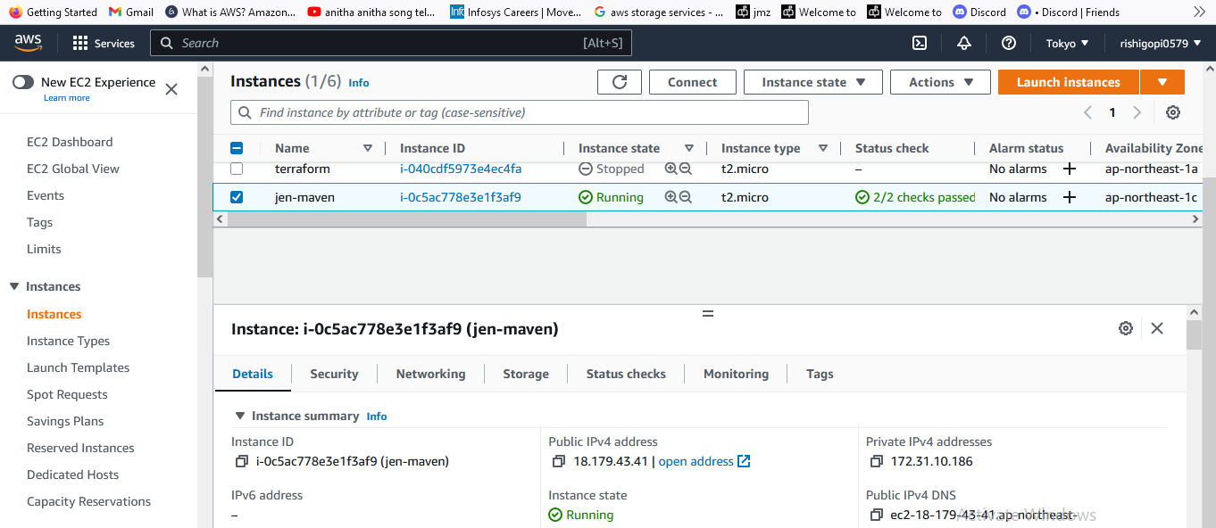

Slide 3
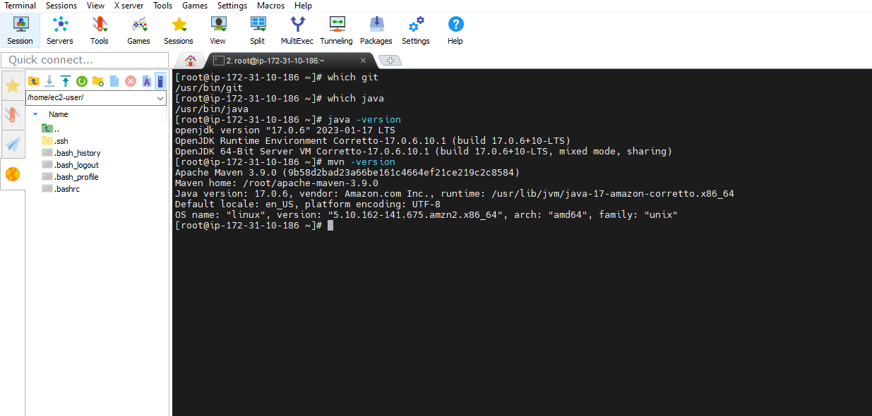

Slide 4
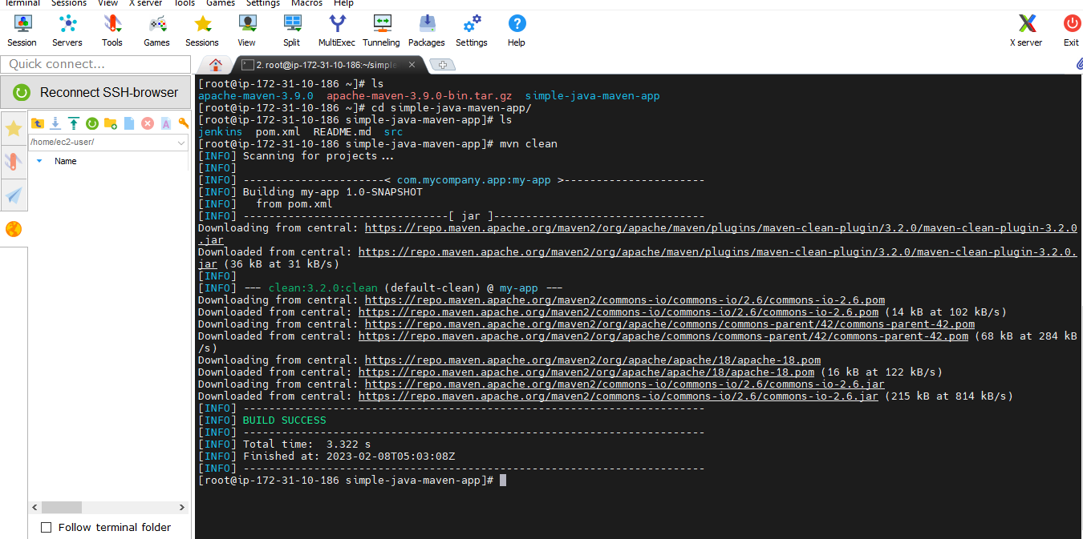
Mvn clean

Slide 5
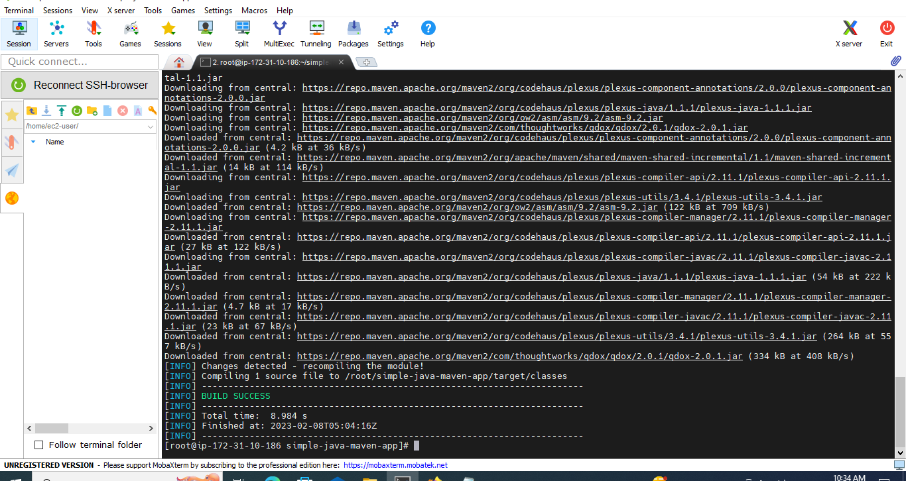
mvn compile

Slide 6
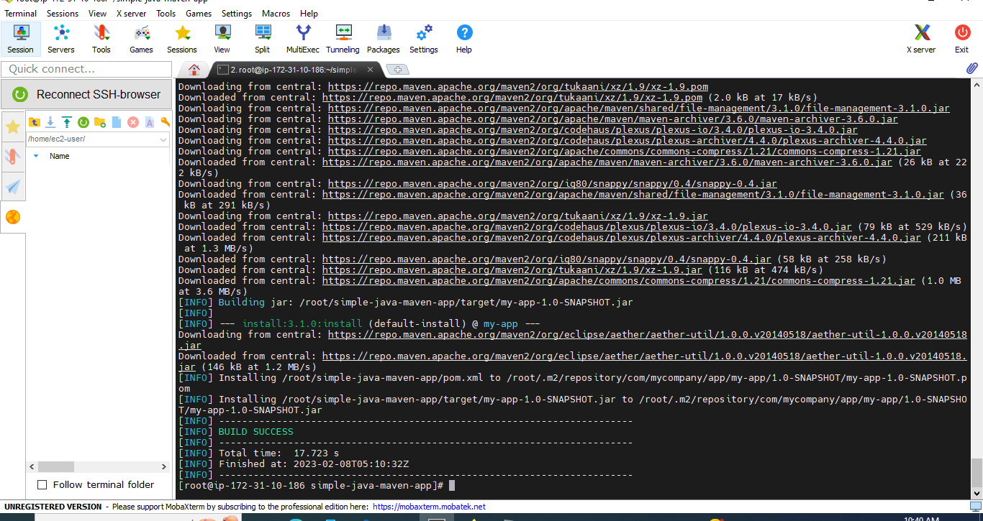
mvn clean install

Slide 7
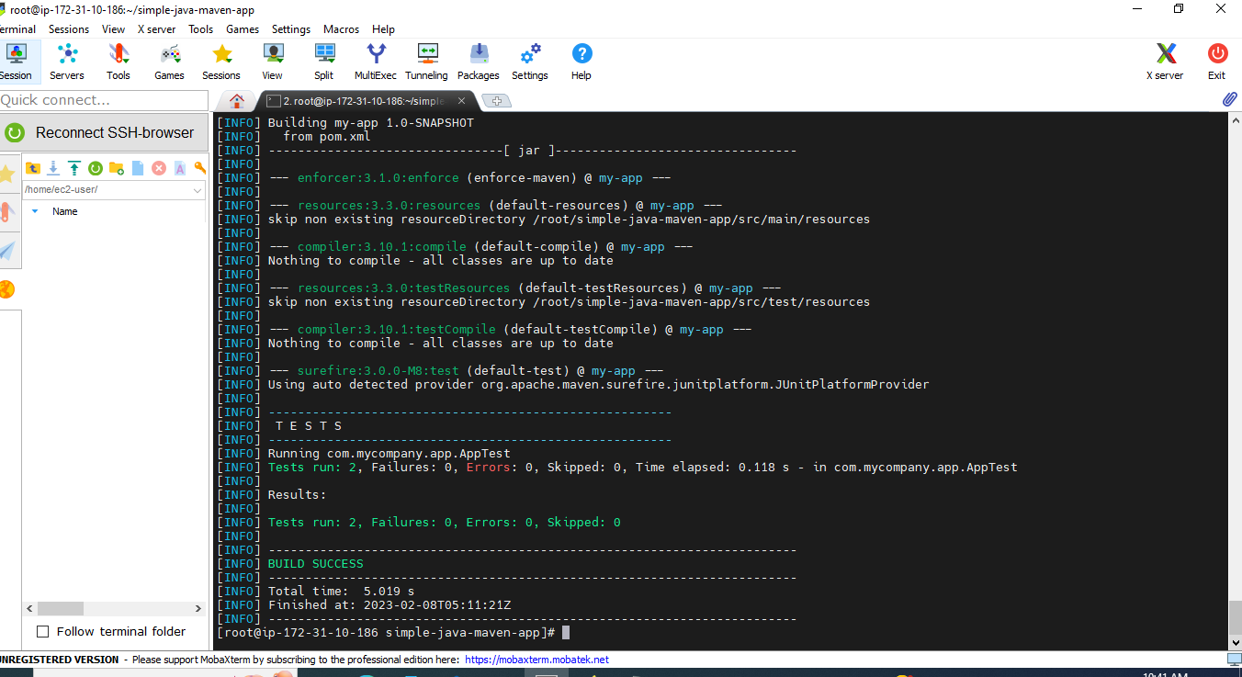
mvn test

Slide 8
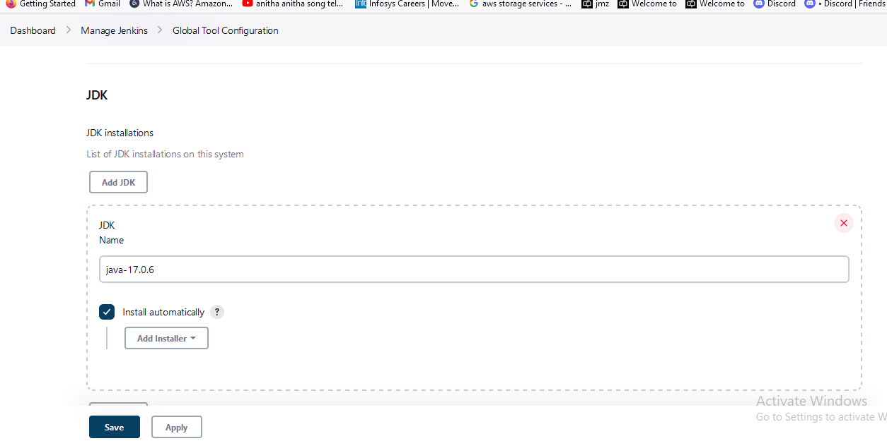
Go to Jenkins Dashboard :
First we add JDk , GIT, MAVEN in –
Go to manage Jenkins –Global Tool configuration click

Slide 9
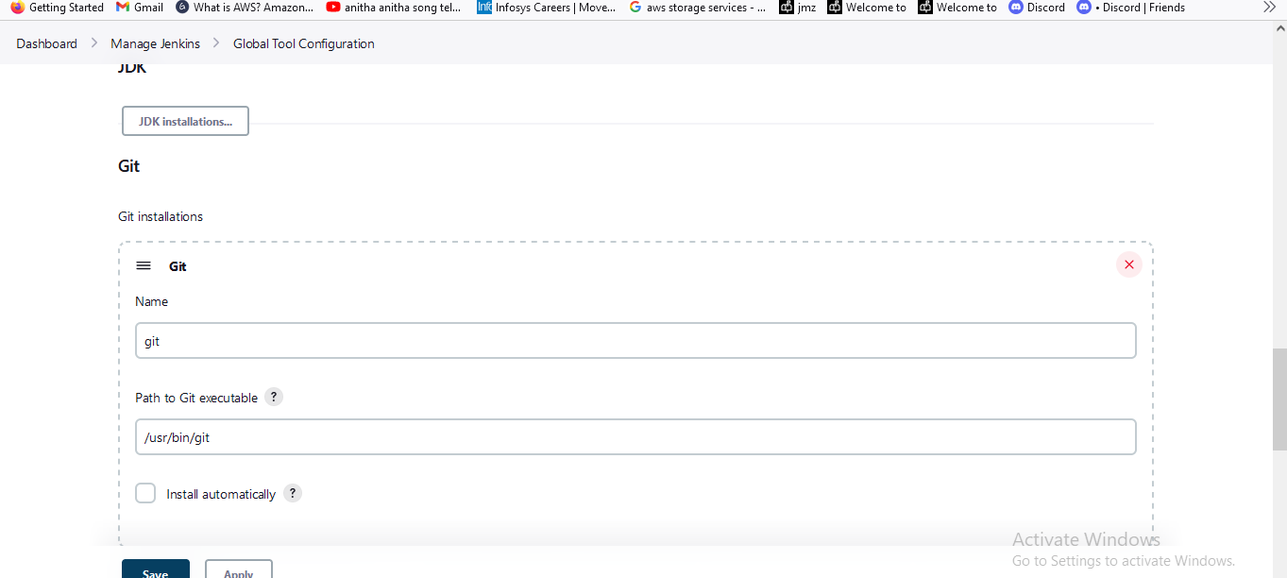
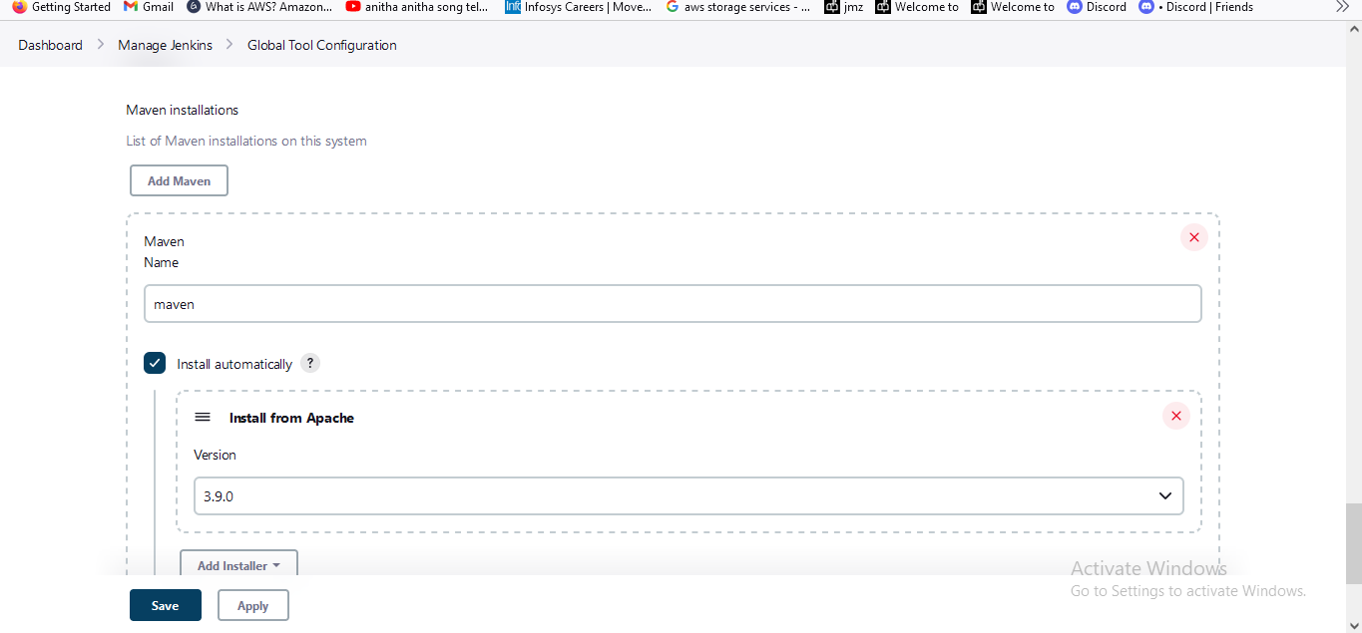

Slide 10
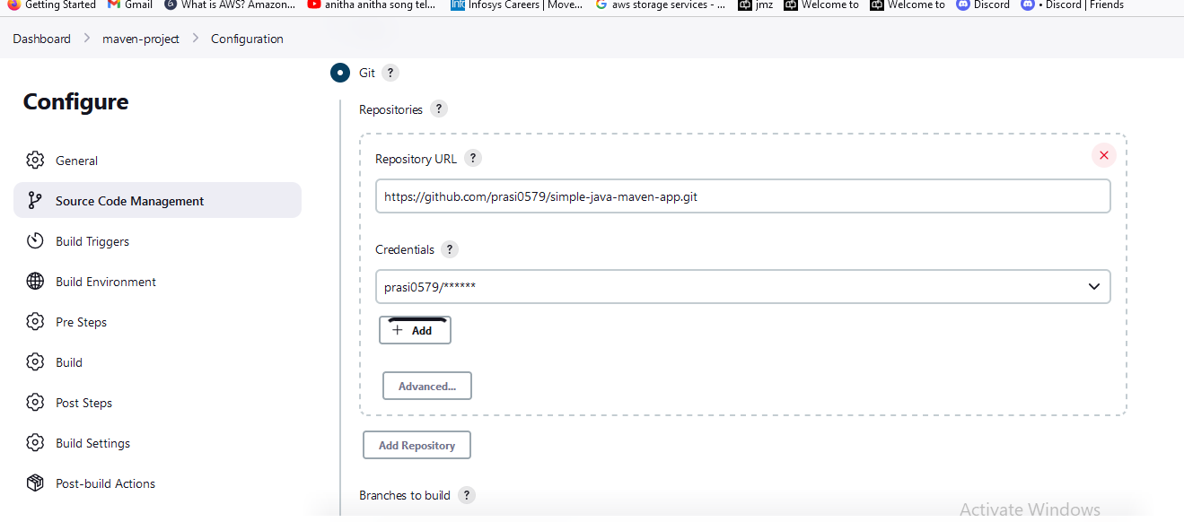
Jenkins Dashboard – create the maven project
open project – Configure -Go inside add the Git hub repository url and give the creditentials

Slide 11
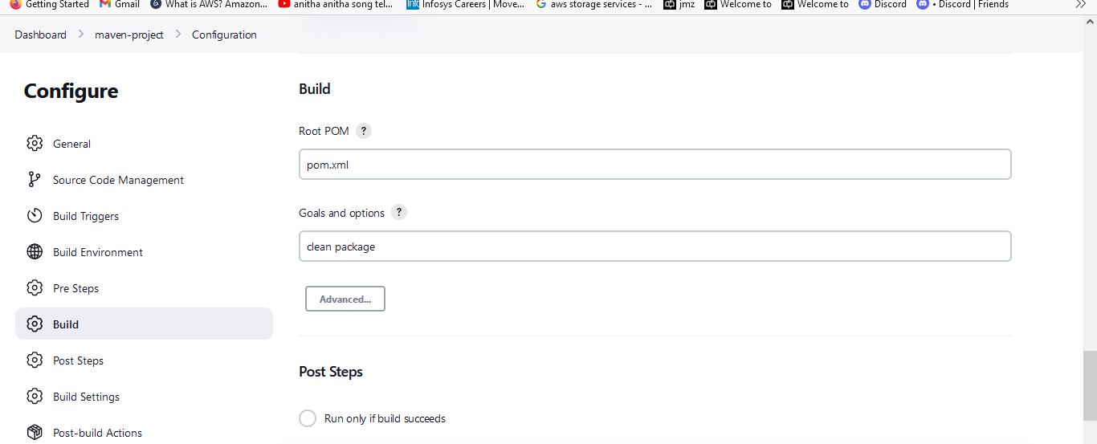

Slide 12
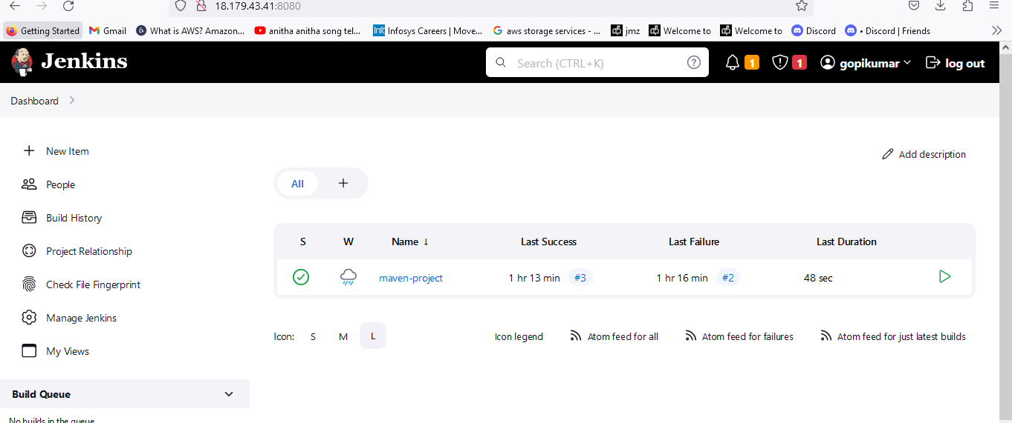

Slide 13
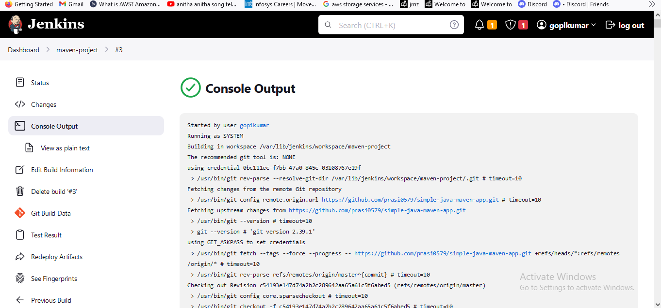

Slide 14
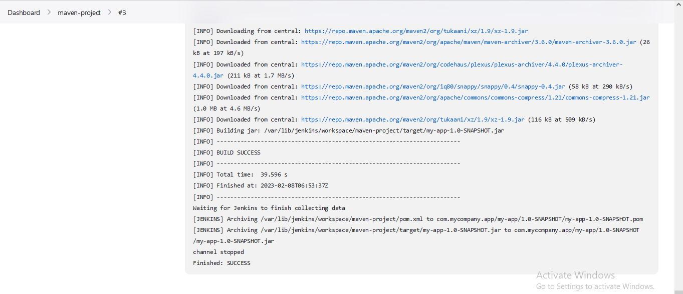

Slide 15
In your Jenkins project configuration, go to the "Source Code Management" section and select "Git".
In the "Build Triggers" section, check the "GitHub hook trigger for GITScm polling" option.
In your GitHub repository, go to "Settings" - "Webhooks" and add a new webhook.
Enter the URL of your Jenkins instance and select "Just the push event".
Save the webhook and test it to ensure that it is working correctly.

Slide 16
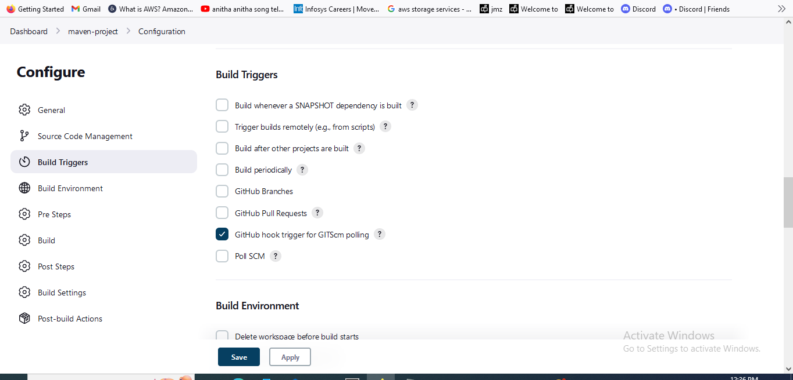

Slide 17
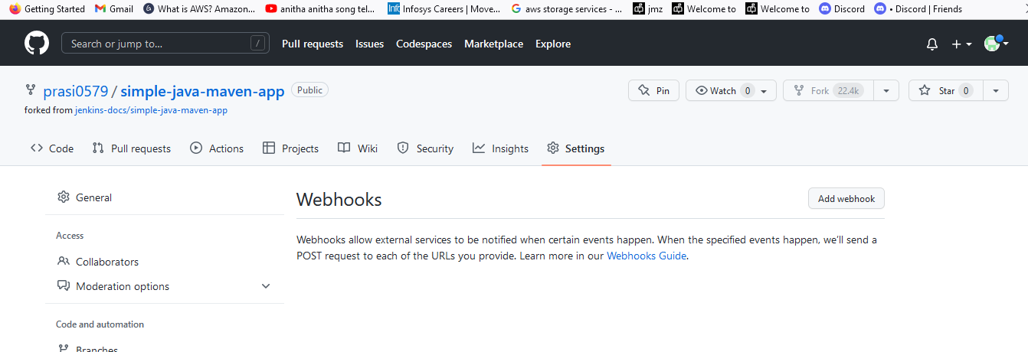
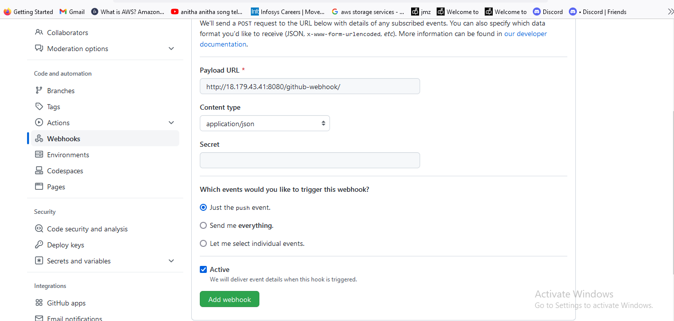

Slide 18
